Slide 1

Hefeng Lai and Peng Zhang
Course: System Software
Code: 24ECSC306
TM
One Pass Assembler
Guided by: Dr. Sujatha C.
Team A1-7
Team Members:
Roll No | Name | USN
113 | Vishwa M. Badachi | 01FE22BCS065
114 | Fardeen Vaddo | 01FE22BCS074
115 | Sai Satya B. V. | 01FE22BCS076
112 | Somashekhar M. Kinagi | 01FE22BCS063

Slide 2

Understanding of OEE
What is a SIC machine?
The SIC (Simplified Instructional Computer) is a hypothetical computer system used for educational purposes.
particularly to teach the principles of computer architecture, machine-level programming, and assembler design.
It provides a simple model of how computers operate at a low level without the complexities of modern hardware.
What is an Assembler?
An assembler is a type of software program that translates assembly language (a human-readable, low-level programming language) into machine code (binary code that a computer's processor can execute directly).

Slide 3
Understanding of OEE
Problem Statement : Design an one pass assembler for SIC Machine.
Objectives :
Develop an translator which generates the object program in a single pass(Reading/Processing the input code only once).
Must resolve forward references and external references in a single pass.
Challenges :
Symbols cannot be referenced before declaring them in a single pass. However, this issue can be resolved by declaring the symbols at the beginning of the code.
The forward referencing problem cannot be solved in case of subroutines while reading the input code only once as the subroutines cannot be declared at the beginning of the code.

Slide 4
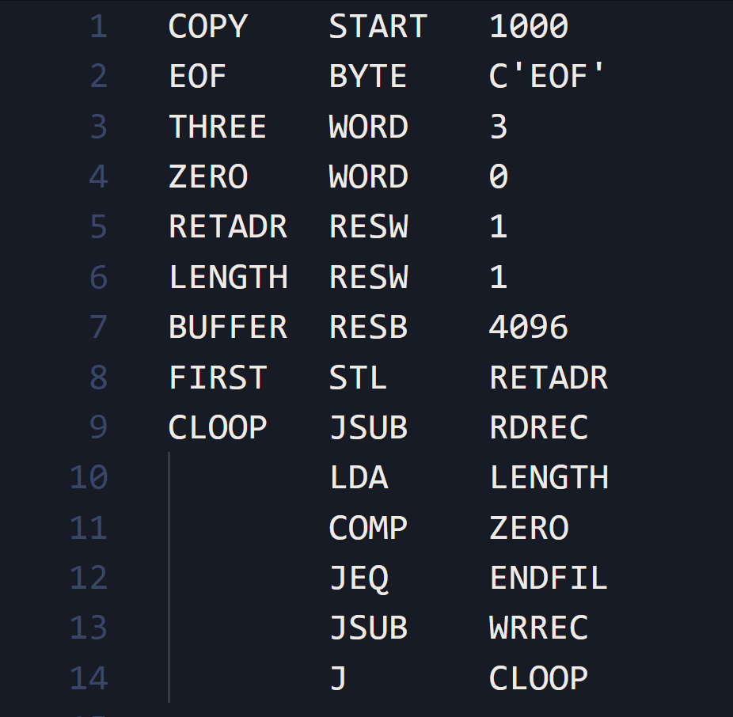
Input
Sample Input: Standard SIC Instructions

Slide 5
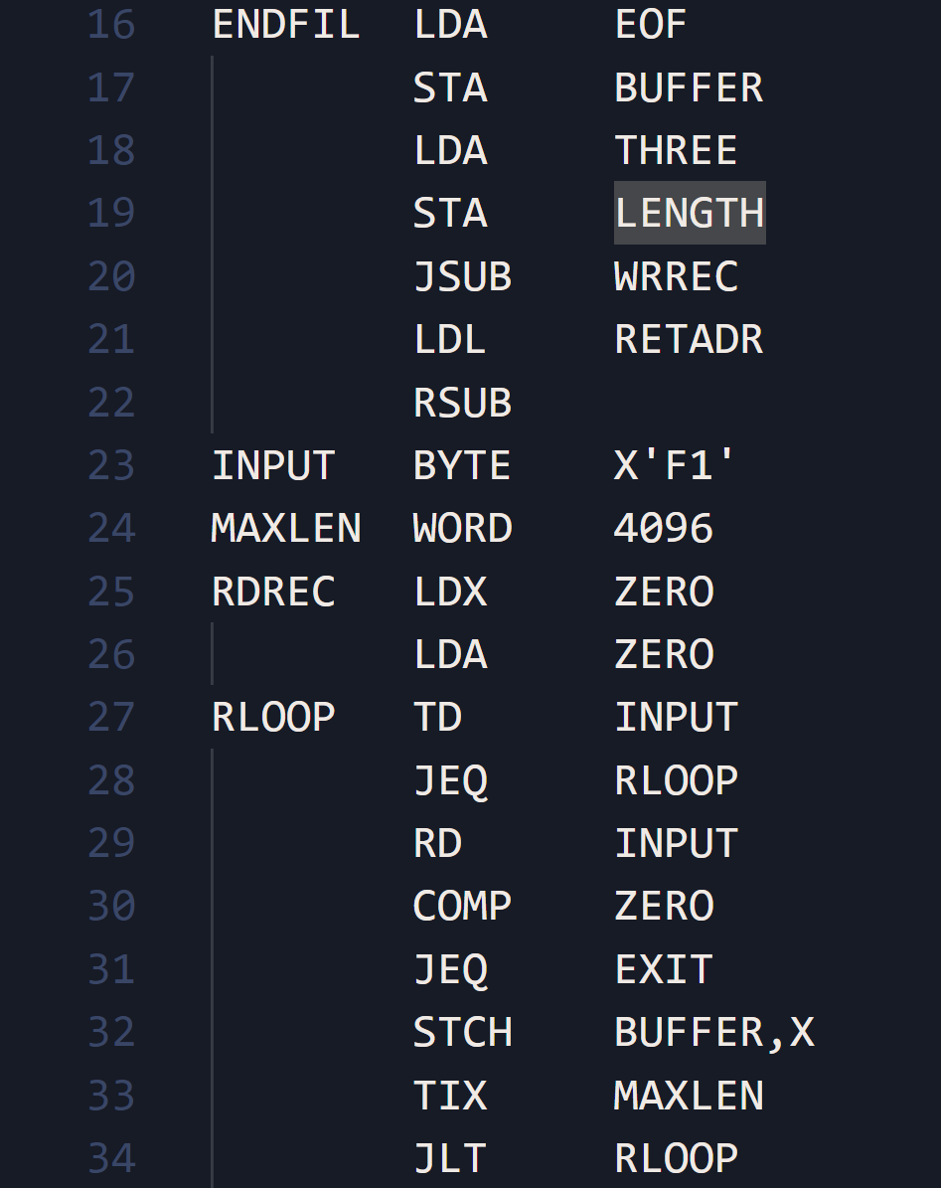
Input

Slide 6
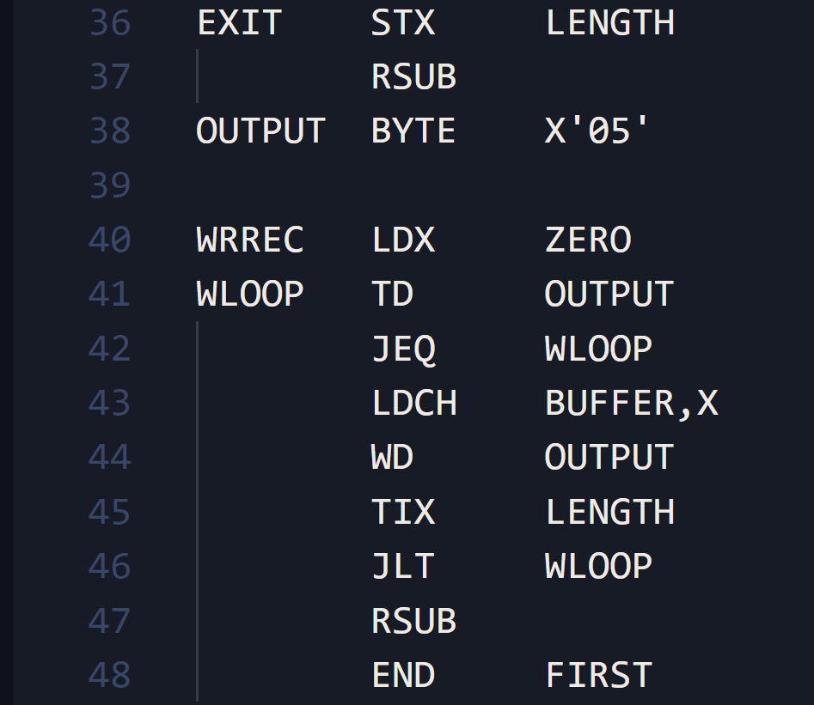
Input

Slide 7
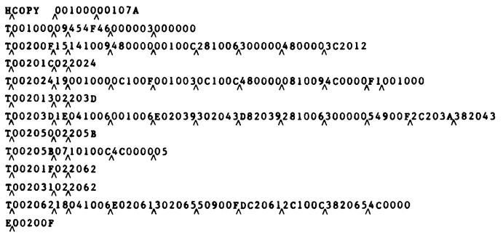
Expected Output
Expected Output: Object Program

Slide 8
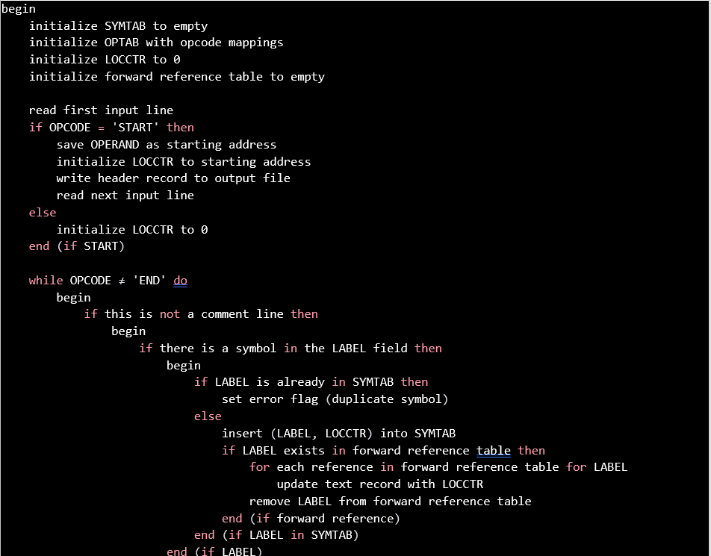
Algorithm

Slide 9
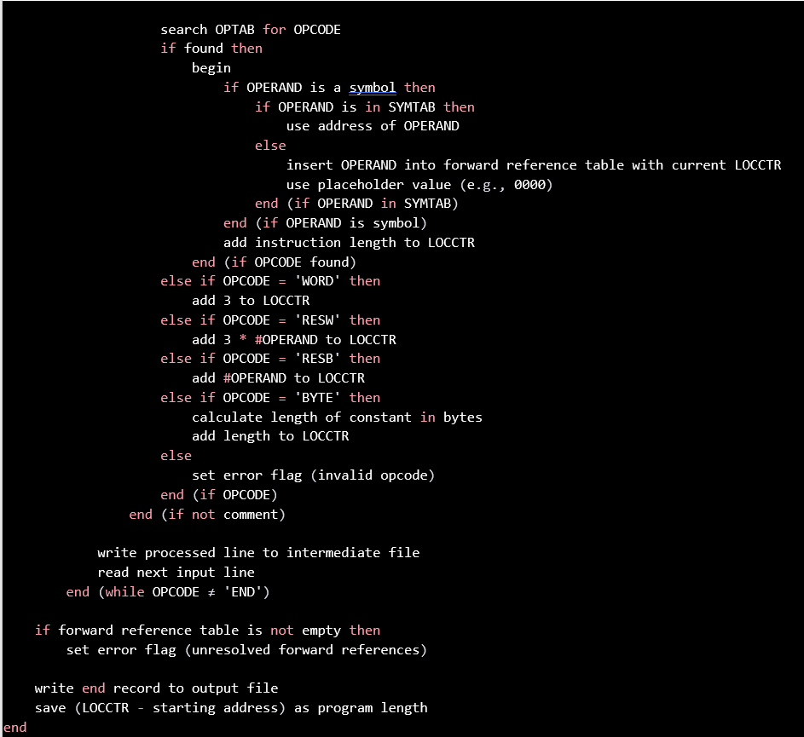
Algorithm

Slide 10
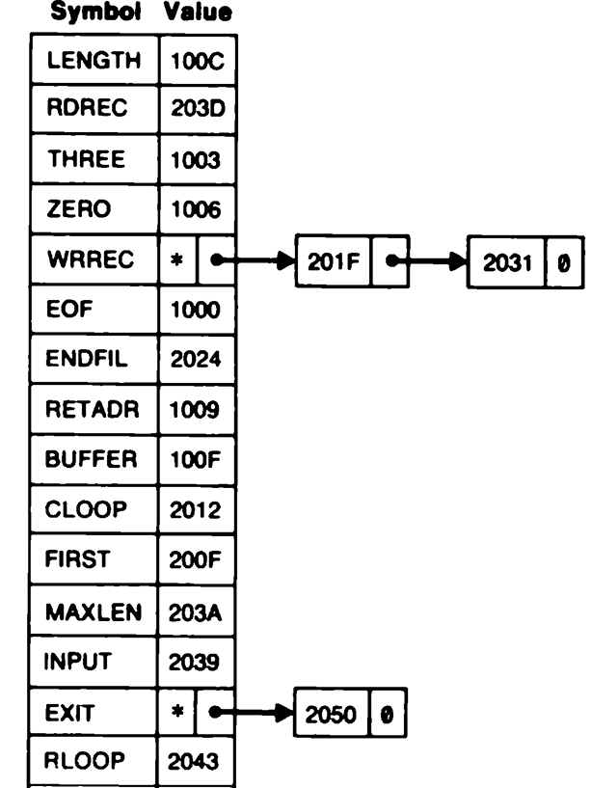
Data Structures
Data structures : Arrays/Linked Lists which will be used to store the info about the unresolved references and then whenever symbol is defined resolve the references pointing to the addresses in linked list.

Slide 11
Thank You

